Slide 1
SQL Server 2008
Performance Monitoring
James Pheiffer

Slide 2
Agenda
Introduction
Performance Monitoring
  PSSDiag
  SQLioSim
  PAL
  SQL Nexus
  Internals Viewer
Scenario

Slide 3
Introduction
James Pheiffer
  GijimaAST
    Intranet Developer
    SharePoint 2003
  BCX
    MOSS 2007
  Microsoft
    Senior Consultant (MOSS)
    PFE (SQL and MOSS)

Slide 4
Performance Monitoring
SQL Server 2008 DMV’s
PSSDiag
SQLioSim
PAL
SQL Nexus
Internals Viewer

Slide 5
Data Management Views (DMV’s)
Out of the box with SQL Server 2008
Examples are:
  sys.dm_exec_query_stats
  sys.dm_exec_procedure_stats
  sys.dm_exec_trigger_stats
  sys.dm_tran_locks
  sys.dm_clr_appdomains
  sys.dm_clr_loaded_assemblies
  sys.dm_clr_properties
  sys.dm_clr_tasks
  sys.dm_exec_cached_plans
  sys.dm_exec_requests
  sys.dm_os_memory_clerks
Performance Statistics Event Class
Holding Locks
Additional DMV’s

Slide 6
PSSDiag
PSSDiag is a culmination of SQLDiag (SQL 2005), BPA, DMV’s, Perfmon, SQL Logs etc.
Analysis Services
Backup a DB
Clone DB Stats
Cluster Info
DB Mail
DB Mirroring
Delete Old Trace Files
Full Text Search
Linked server Configuration
Merge Replication
Missing Perfmon Counters
MS info
OS Drivers
Replication
Reporting Services
Security
Service Broker
SQL 2008 Backup MDW
SQL 2008 Perf Stats
SQL Backup Restore
SQL Base
SQL Best Practices
SQL Blocking
SQL Dumps
SQL Memory Error
SQL Setup
SQL Agent
SQL Mail

Slide 7
Dependencies
PSSDiag captures SQL Specific information
Configured in a configuration UI
Resulting file is zipped into a self extracting PSSD.exe file
PSSDiag.exe needs to be run physically on the SQL server
It needs to be run on each node if the SQL environment is clustered
It can be run remotely too many scripts cannot be executed
Small percentage in loss of performance while PSSDiag is running
Therefore PSSDiag should be run just before issue is replicated allowing you to capture the issue
Depending on the PSSDiag configuration, the output files can become quite large especially when running Perfmon for long periods of time

Slide 8
Output Files
Current System State
srv_TLIST.TXT “tlist -t” output
srv_Running_Services.TXT NET START output
srv_PROCESS.* current running processes and their loaded DLLs
srv_IMAGE_FILE_EXEC_OP_REG.TXT Image File Execution Options reg key
SQL
srv_SQL(x86)FILES.* files in Program Files(x86)\Microsoft SQL Server
srv_SQLFILES.* files in Program Files\Microsoft SQL Server
srv_SQLRIGHTS.TXT user rights needed for SQL services (showpriv)
srv_SetupLogs_* SQL 2000/2005 setup logs
srv_SchedLgU.Txt Task Scheduler log (for cluster setup issues)
srv_OLAP_*_FILES.* Analysis Services files
Cluster
srv_CLUSTERFILES.* files in C:\Windows\Cluster
srv_WLBS.TXT WLBS config info
srv_CLUSTERINFO.TXT cluster.exe output (resources, quorum), clust reg
srv_CLUSTER_REGISTRY.HIV HKLM\Cluster
srv_CLUSTER_cluster.log cluster log
srv_CLUSTER_chkdsk* chkdsk output
srv_CLUSTER_CLUSMPS.TXT clusmps.exe output
I/O
srv_FIBRE_CHANNEL_INFO.TXT fcinfo.exe output
srv_FILTERDRIVERS.TXT fltrfind.exe output

Slide 9
Output Files
Misc
srv_IE*.TXT IE setup logs
srv_MISC.TXT net file, net config, net share, etc
srv_METABASE.txt IIS metabase
Basic System Config
srv_BOOT_INI.TXT BOOT.INI
srv_DRIVERS.* driver list from checksym
srv_PSTAT.TXT pstat.exe output
srv_SCHEDULE.* currently scheduled tasks (schtasks, at)
srv_TERMSERV.TXT Terminal Services state
srv_TRACING.TXT reg keys incl. HKLM\SOFTWARE\Microsoft\Tracing
srv_STARTUP.TXT autorun reg keys and directories (e.g. runonce key)
srv_CONFIG_AUTO.TXT config.nt and autoexec.nt
srv_SYSTEM32_DLL/EXE/SYS.* .DLL, .SYS, and .EXE files from System32
srv_SYSTEMINFO.TXT systeminfo.exe output
srv_HOTFIX.TXT hotfix reg keys, qfecheck.exe output
srv_GPRESULT.TXT gpresult.exe output

Slide 10
Output Files
Basic System Config
srv_BOOT_INI.TXT BOOT.INI
srv_DRIVERS.* driver list from checksym
srv_PSTAT.TXT pstat.exe output
srv_SCHEDULE.* currently scheduled tasks (schtasks, at)
srv_TERMSERV.TXT Terminal Services state
srv_TRACING.TXT reg keys incl. HKLM\SOFTWARE\Microsoft\Tracing
srv_STARTUP.TXT autorun reg keys and directories (e.g. runonce key)
srv_CONFIG_AUTO.TXT config.nt and autoexec.nt
srv_SYSTEM32_DLL/EXE/SYS.* .DLL, .SYS, and .EXE files from System32
srv_SYSTEMINFO.TXT systeminfo.exe output
srv_HOTFIX.TXT hotfix reg keys, qfecheck.exe output
srv_GPRESULT.TXT gpresult.exe output
MDAC File and Registry
srv_COMMON_SYSTEMFILES.* files in Program Files\Common Files\System
srv_MDAC_DASETUP.TXT dasetup.log
srv_MDAC_Exception*_REG.TXT HKLM\...\Setup\ExceptionComponents
srv_MDAC_GAC_SYSTEM_DATA.TXT files in c:\windows\assembly\gac\system.data
srv_MDAC_GAC_SYSTEM_XML.TXT files in c:\windows\assembly\gac\system.xml
srv_MDAC_HKxx_ODBC_REG.TXT ODBC settings from HKLM and HKCU
srv_MDAC_ORACLE_*_REG.TXT Oracle OLEDB and OCI registry keys
srv_HKCR_CLSID_REG.TXT HKCR\CLSID registry key
srv_NETFRAMEWORK_REG.TXT HKLM\SOFTWARE\Microsoft\.NETFramework
Network
srv_IPSEC.TXT IPSec registry keys, ipseccmd
srv_NETINFO.TXT netstat, arp, ipconfig, rpcdump, nbtstat, net reg keys
srv_NETDIAG.TXT netdiag.exe output
srv_HOST.TXT HOSTS file
srv_LMHOST.TXT LMHOSTS file

Slide 11
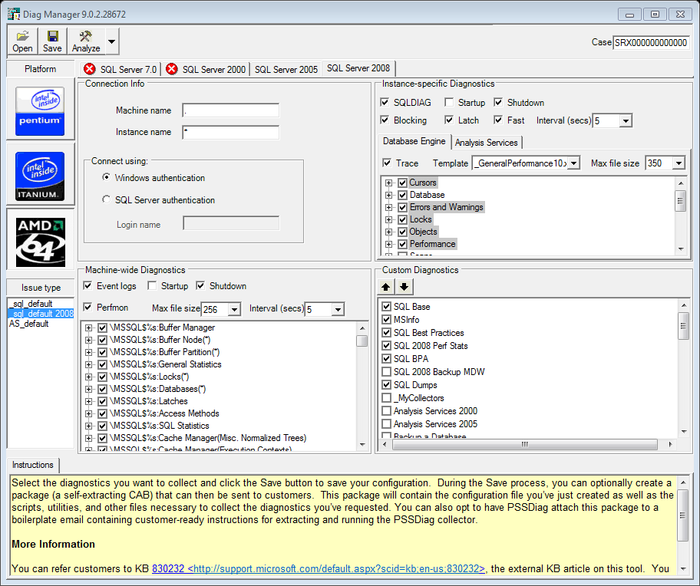
PSSDiag

Slide 12
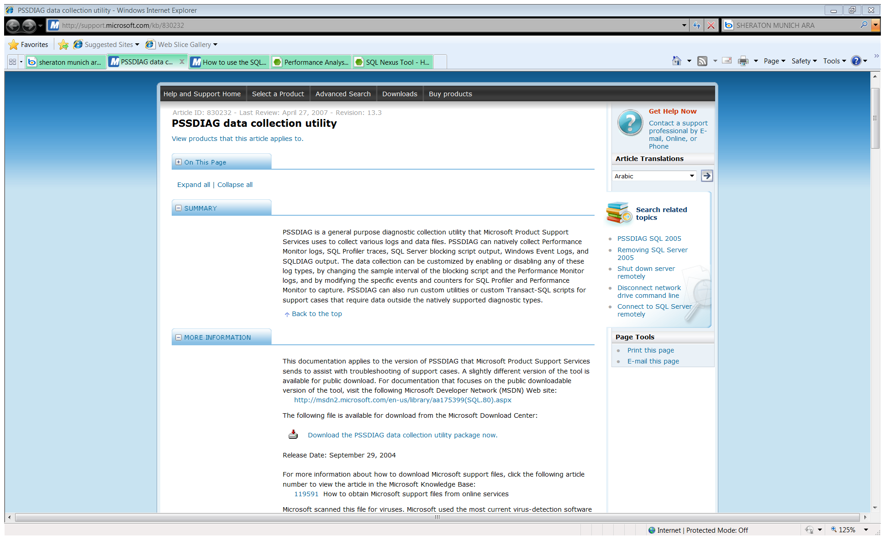
PSSDiag

Slide 13
SQLioSim
Configurable tool
Simulates disk IO according to SQL Server User’s usage patterns
Load the server with various types of loads to help replicate issues
Error logging UI, provides errors while loading the server
  X86
  X64
  Itanium

Slide 14
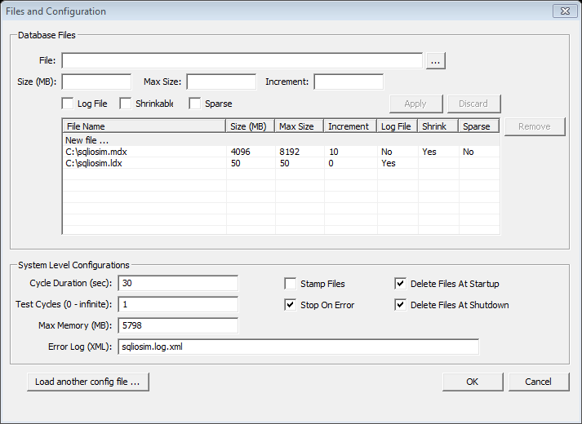
SQLioSim

Slide 15
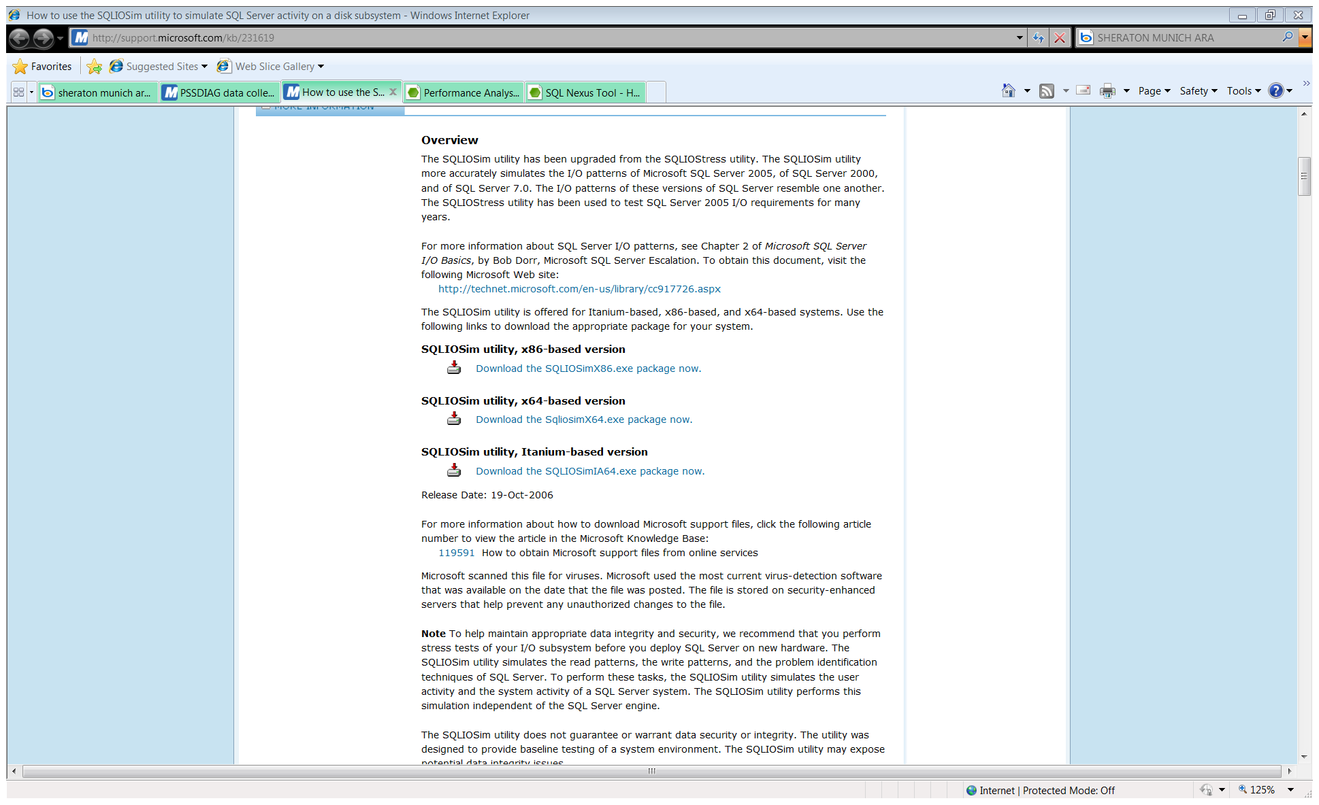
SQLioSim

Slide 16
PAL
(Performance Analysis of Logs)
Powerful tool that reads in a performance monitor counter log and analyses it using complex, but known thresholds (provided)
Generates HTML based report which graphically charts important performance counters and alerts when thresholds are exceeded
This is a VBScript and requires Microsoft LogParser (free download)
Thresholds files for most of the major Microsoft products such as IIS, MOSS, SQL Server, BizTalk, Exchange, and Active Directory
An easy to use GUI interface which makes creating batch files for the PAL.vbs script
Creates an HTML based report for ease of copy/pasting into other applications
Analyzes performance counter logs for thresholds using thresholds that change their critieria based on the computer's role or hardware specs

Slide 17
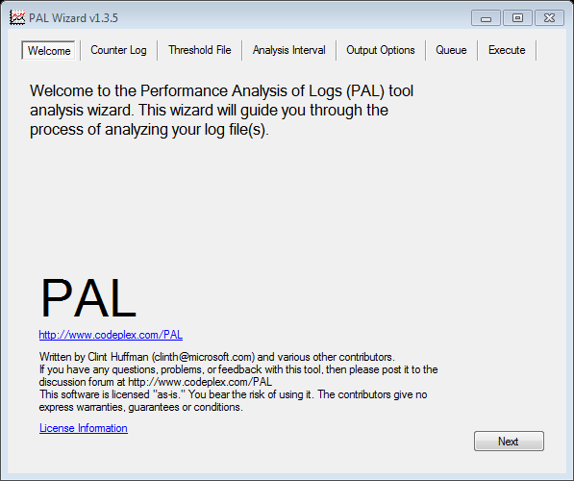
PAL

Slide 18
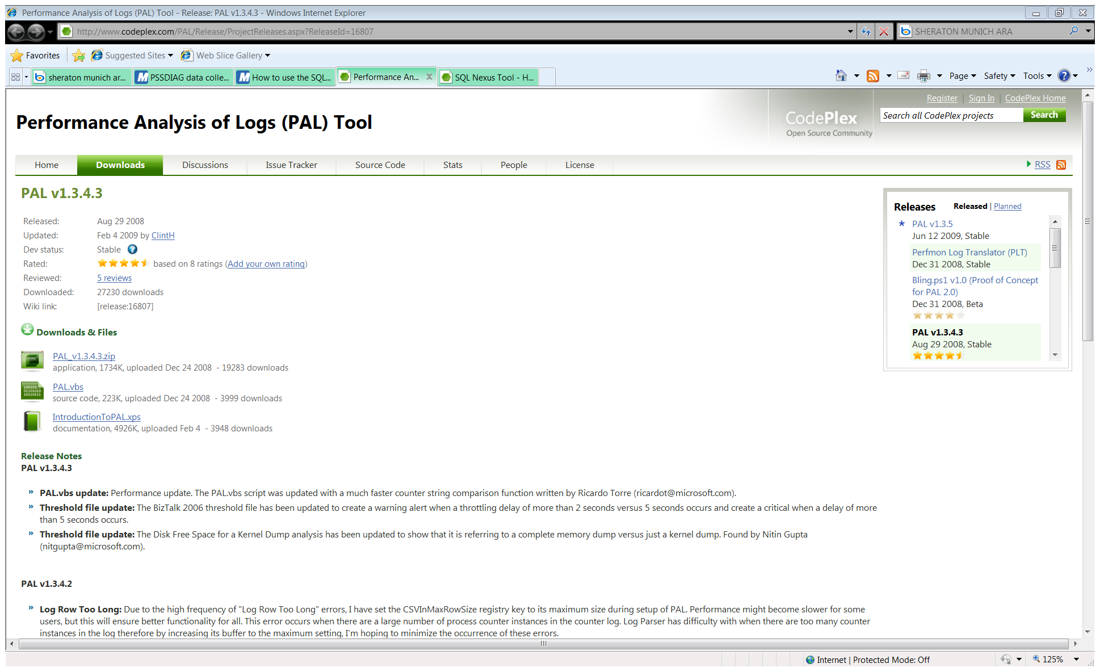
PAL

Slide 19
SQL Nexus
Tool to help identify root causes of SQL Server performance issues
Loads and analyses performance data collected by SQLDiag and PSSDiag
Quickly and easily load SQL Trace files; T-SQL script output, including SQL DMV queries; and Performance Monitor logs into a SQL Server database for analysis
Once the data is loaded, you can fire up several different charts and reports for analysis
Trace aggregation to show the TOP N most expensive queries (using ReadTrace)
Wait stats analysis for visualizing blocking and other resource contention issues (based on the new SQL 2005 Perf Stats Script or SQL 2008 Perf Stats)
Uses the SQL Server Reporting Services client-side report viewer (it does not require an RS instance)
Expand/collapse report regions (sub-reports) for easier navigation of complex data, export or email reports and supports exporting in Excel, PDF, and several other formats

Slide 20
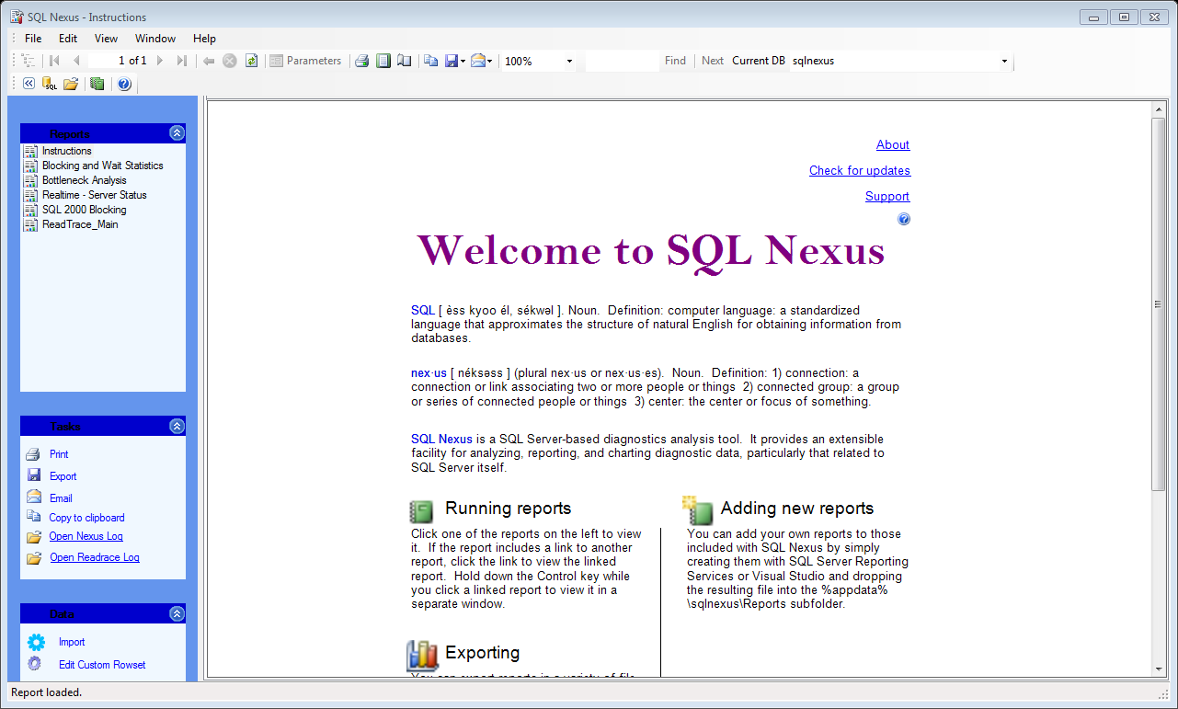
SQL Nexus

Slide 21
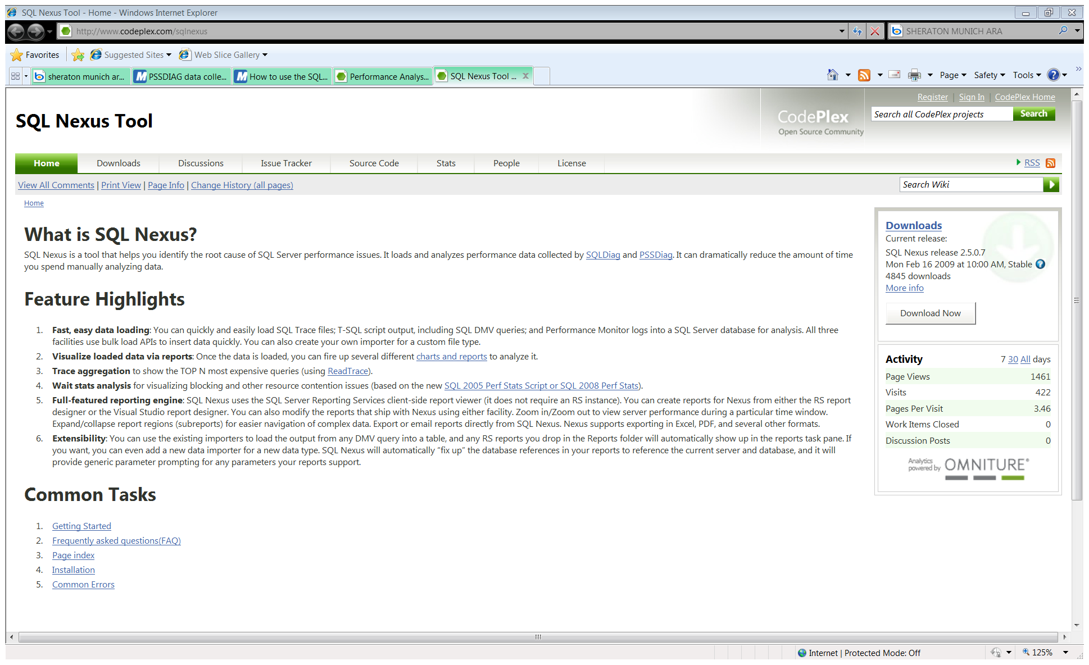
SQL Nexus

Slide 22
Internals Viewer
Internals Viewer is a tool for looking into the SQL Server storage engine and seeing how data is physically allocated, organised and stored
Allocation Map
  Displays the physical layout of tables and indexes
  Displays PFS status
  Overlay pages in the Buffer Pool
Page Viewer
  Displays Data pages including forwarding records and sparse columns
  Displays Index pages
  Displays allocation pages (IAM, GAM, SGAM, DCM, and BCM pages)
  Displays pages with SQL Server 2008 row and page compression

Slide 23
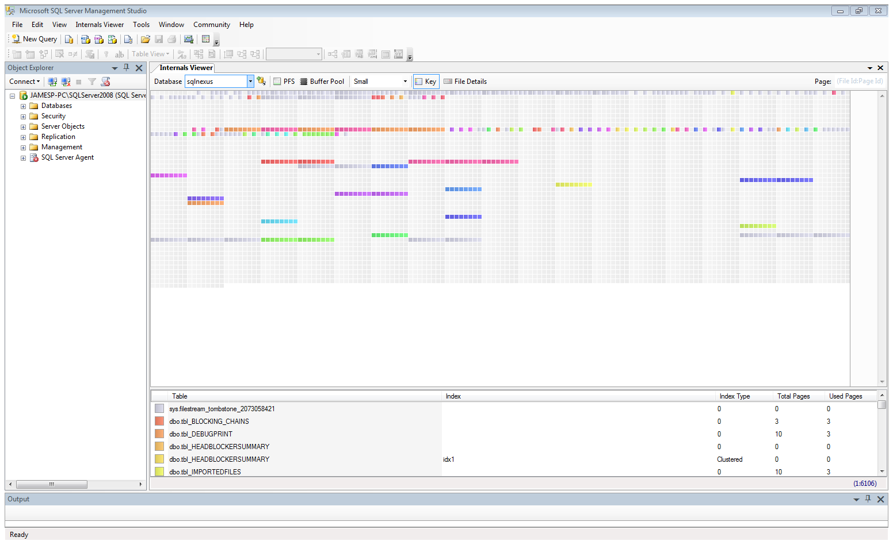
Internals Viewer

Slide 24
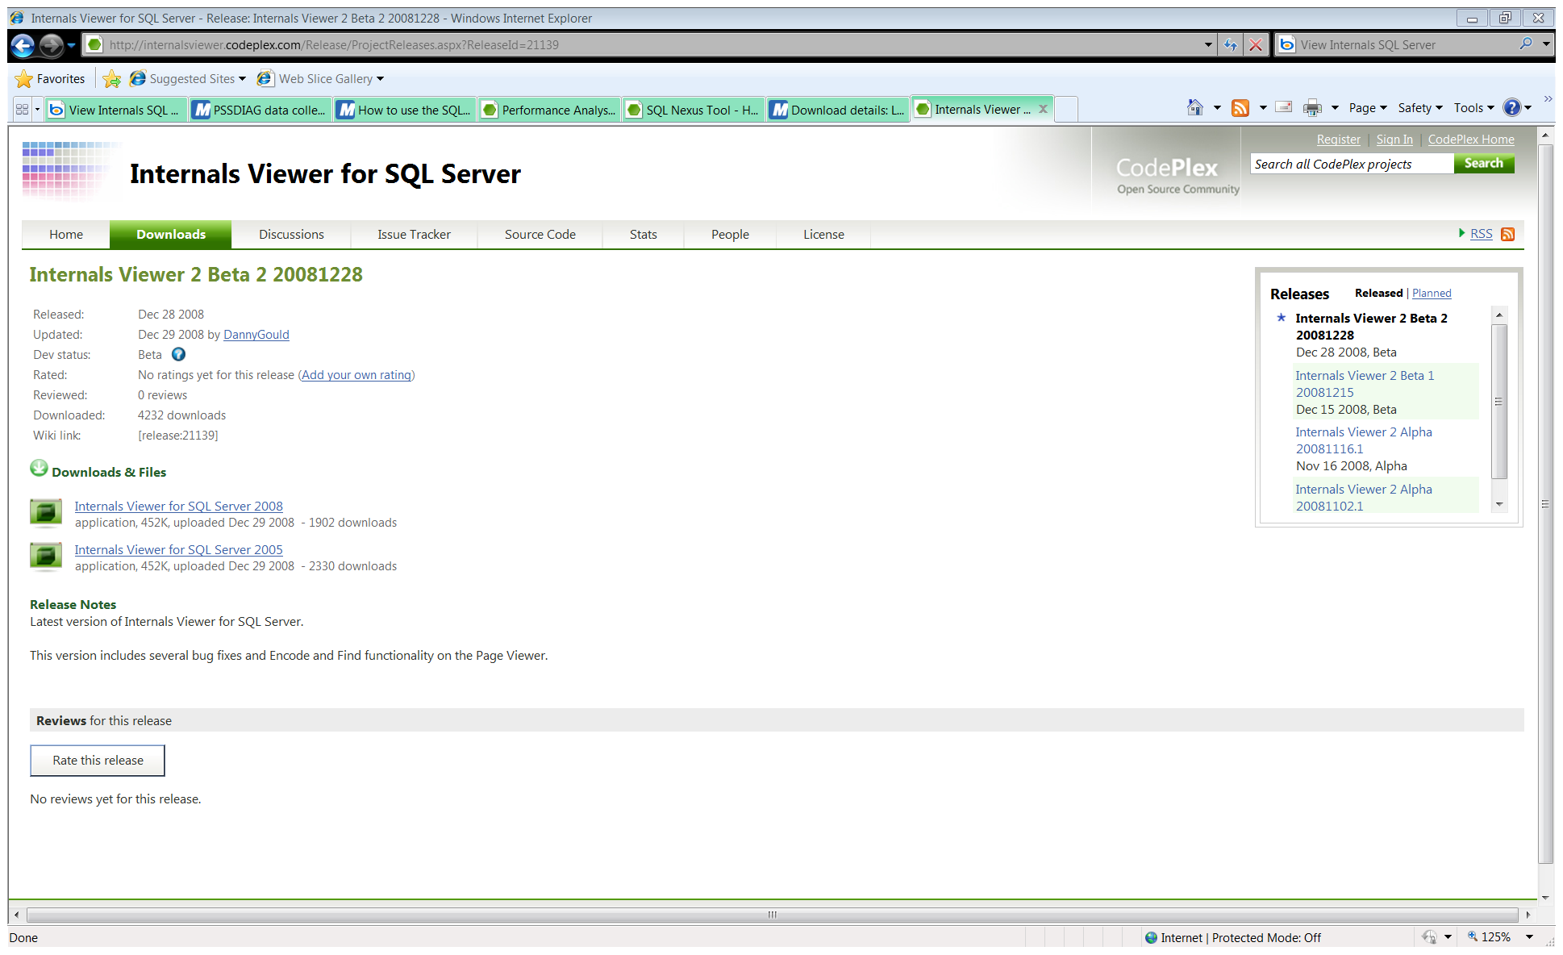
Internals Viewer

Slide 25
References
PSSDiag (http://support.microsoft.com/kb/830232)
SQLioSim (http://support.microsoft.com/kb/231619)
PAL (http://www.codeplex.com/PAL/Release/ProjectReleases.aspx?ReleaseId=16807)
  Microsoft Log Parser 2.2 (http://www.microsoft.com/downloads/details.aspx?FamilyID=890cd06b-abf8-4c25-91b2-f8d975cf8c07&displaylang=en)
SQL Nexus (http://www.codeplex.com/sqlnexus)
Internals Viewer (http://internalsviewer.codeplex.com/Release/ProjectReleases.aspx?ReleaseId=21139)

Slide 26

Questions / Scenario

